Slide 1

Intern Management System
Team B
Sprint 1 Playback – Design & Bootstrap
Client: Food Systems Collective | Team B: Post-Recruitment Mentor & Intern Experience
1

Slide 2














Original Plan
Sprint 1 — Design & Bootstrap
FOOD SYSTEMS
Our Sprint 1 Commitment
COLLECTIVE
1
2
3
4
5
Validated Requirements
User Flows & Interface Designs
Digital Prototype
Shared-Integration Architecture
SPRINT 2 READY
Core MVP Implementation
LIVE & ACCESSIBLE INFRASTRUCTURE
No working product features were expected in Sprint 1.

Slide 3
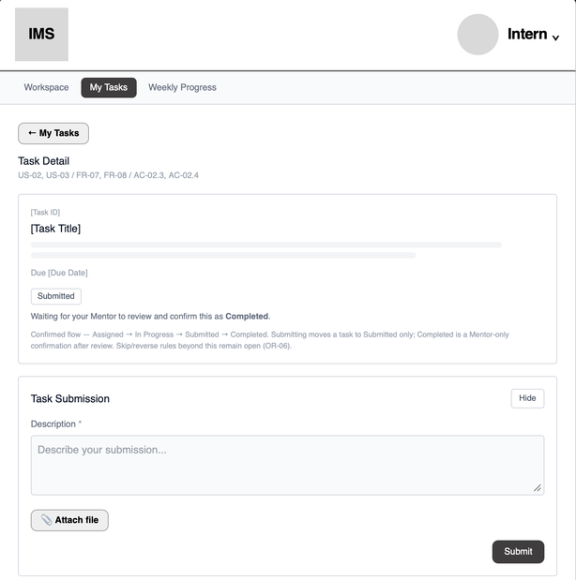
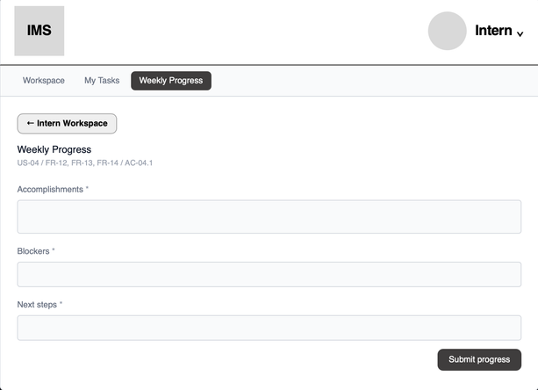
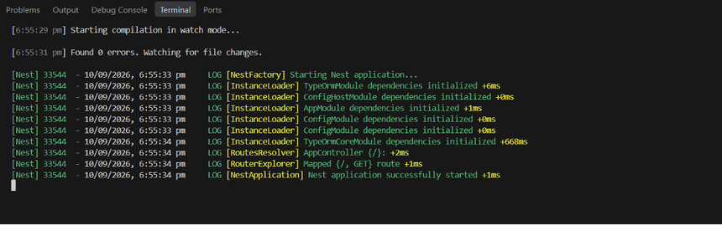
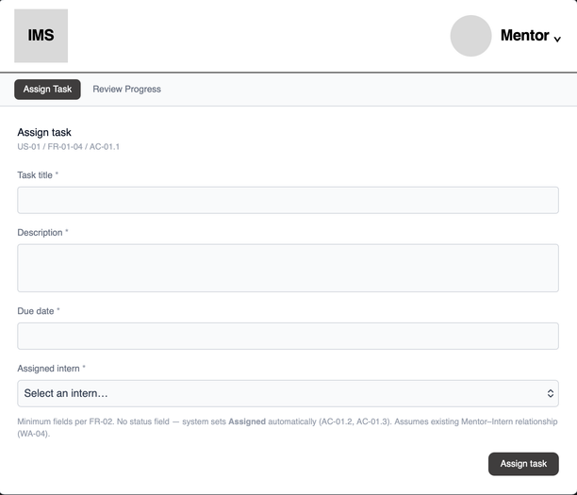
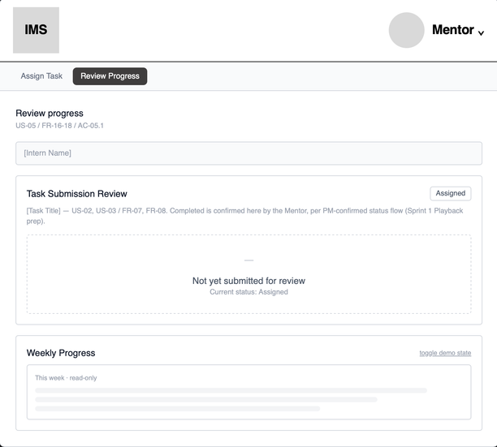
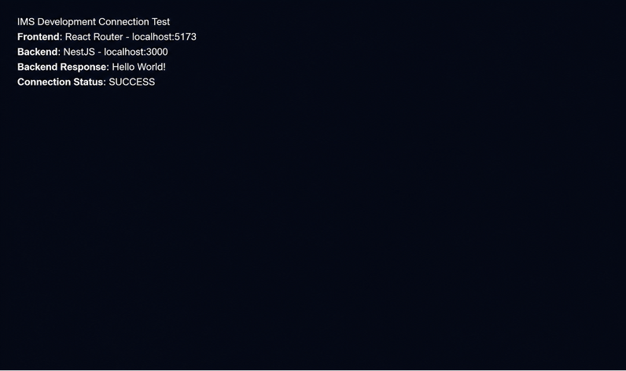
Actual Achievement
Sprint 1 Outcomes — Evidence
01 — DIGITAL DESIGN & PROTOTYPE
02 — LIVE DEVELOPMENT INFRASTRUCTURE
Connected Core MVP Prototype
Assign Task → Work on Task → Task Submission → Weekly Progress → Mentor Review
View Core MVP Prototype
3
Sprint 1 Outcome: Design validated + technical foundation established for Sprint 2 implementation.

Slide 4

Why It Matters
✓ For Mentors
Better visibility and control
Assign tasks, review Intern progress, and distinguish submitted work from completed work.
⇄ For Interns
Clearer work and progress reporting
Interns can clearly see assigned work, submit task-specific work, and report overall weekly progress.
◈ For FSC
More structured internship management
Creates a clearer and more consistent way to track assigned work and Intern progress within one shared IMS.
4

Slide 5
Blockers, Learnings & Open Questions
CLIENT FEEDBACK
Feedback was not always received early enough for continuous validation.
→ Weekly client reviews in Sprint 2
CROSS-TEAM DEPENDENCIES
Two teams are contributing to one shared IMS, creating coordination and integration dependencies.
→ Regular Team A/B alignment and integration checks
SCOPE & IMPLEMENTATION
Some design decisions may require refinement once implementation begins.
→ Protect the Core MVP and validate incrementally in Sprint 2
5

Slide 6
Sprint 1
Task Allocation
Team B contributions across PM, BA, UX, and DEV roles during the Design & Bootstrap sprint.
Jianqi Lu — Project Manager
[SPRINT MANAGEMENT] - Sprint 1 Scope and Planner Setup : 120
[PROJECT MANAGEMENT] - Sprint 1 Dependency, Risk and Coordination Setup : 120
[SPRINT MANAGEMENT] - Week 2 Scope, Progress and Dependency Review : 120
[STAKEHOLDER MANAGEMENT] - Client and Supervisor Feedback Coordination : 120
[SPRINT MANAGEMENT] - Week 3 Validation and Sprint 2 Readiness Coordination : 120
[SPRINT PLAYBACK] - Sprint 1 Playback Preparation and Readiness Review : 120
[TECHNOLOGY MEETING] - Team B Technology Meeting : 30
[CROSS-TEAM MEETING] - Team A/B Integration and Alignment Meeting : 60
[CROSS-TEAM MEETING] - Team A/B Sprint 1 Playback Rehearsal : 60
[SPRINT PLAYBACK] - Sprint 1 Playback Meeting with Supervisors : 30
Shakthijhaa Sivagnanam — Business Analyst
[REQUIREMENTS] - Team B Core MVP Scope and Workflow Definition : 120
[REQUIREMENTS] - Client Requirements and Process Review : 120
[REQUIREMENTS] - Core MVP User Stories and Acceptance Criteria : 60
[REQUIREMENTS] - Scope Change and Cross-Team Requirements Review : 120
[BA REVIEW] - Core MVP Wireframe Requirements Review : 60
[REQUIREMENTS] - Final Core MVP Requirements Consolidation : 120
[CROSS-TEAM MEETING] - Team A/B Integration and Alignment Meeting : 60
[CROSS-TEAM MEETING] - Team A/B Sprint 1 Playback Rehearsal : 60
[SPRINT HANDOFF] - Requirements Refinement and Sprint 2 Handoff : 120 (Backlog)
[SPRINT PLAYBACK] - Sprint 1 Playback Meeting with Supervisors : 30
Faridullah Jabbar Khil — UX Designer
[UX DESIGN] - Core MVP User Flow Definition : 120
[UX DESIGN] - Core MVP Early Wireframes : 120
[UX DESIGN] - Core MVP Detailed Wireframes : 120
[UX] - Core MVP Wireframe Review, Revision and Prototype : 120
[UX DESIGN] - Shared IMS Design Alignment and Detailed Core MVP Prototype : 120
[CROSS-TEAM MEETING] - Team A/B Integration and Alignment Meeting : 60
[CROSS-TEAM MEETING] - Team A/B Sprint 1 Playback Rehearsal : 60
[SPRINT HANDOFF] - Prototype Refinement and Sprint 2 Design Handoff : 120 (Backlog)
[SPRINT PLAYBACK] - Sprint 1 Playback Meeting with Supervisors : 30
Chan Hoang Truong — Developer
[INFRASTRUCTURE] - Development Environment and Project Bootstrap : 120
[INFRASTRUCTURE] - Database and Technical Infrastructure Bootstrap : 120
[TECHNICAL ARCHITECTURE] - Core Data and API Architecture Bootstrap : 120
[TECHNICAL ARCHITECTURE] - Authentication, RBAC and Shared IMS Integration Definition : 120
[INFRASTRUCTURE] - Team 40 Database and Development Readiness Setup : 120
[TECHNOLOGY MEETING] - Team B Technology Meeting : 30
[CROSS-TEAM MEETING] - Team A/B Integration and Alignment Meeting : 60
[CROSS-TEAM MEETING] - Team A/B Sprint 1 Playback Rehearsal : 60
[SPRINT HANDOFF] - Technical Refinement and Sprint 2 Development Handoff : 120 (Backlog)
[SPRINT PLAYBACK] - Sprint 1 Playback Meeting with Supervisors : 30

Slide 7
SPRINT 1 — KEY TIMELINE
SPRINT 2 — NEXT STEPS
03 AUG — Project Kick-off Meeting
Team B project initiation & client introduction
↓
12 AUG — Joint Meeting with Team A & Client
Initial cross-team and client alignment
↓
18 AUG — Client Requirements Review
First Core MVP scope reduction
↓
21 AUG — Core MVP Refinement & Client Sign-off
Second scope reduction → Final proposal signed
↓
07 SEP — Technology Meeting
Technical direction & Sprint 2 readiness review
↓
09 SEP — Team A/B Integration Meeting
Shared IMS integration & cross-team alignment
↓
10 SEP — Playback Preparation & Rehearsal
Final Sprint 1 readiness review
↓
11 SEP — SPRINT 1 PLAYBACK
TODAY
Sprint 2 Goal: Turn the validated Sprint 1 design into a working Core MVP.
Implement Core MVP
Build the confirmed Mentor and Intern workflows.
Shared IMS Integration
Integrate Team B functionality with Team A and the shared system foundation.
Weekly Client Validation
Review working progress with FSC every week.
Test & Refine
Validate functionality and resolve remaining workflow, access and integration issues.

